Slide 1






LEAGUE OF LEGENDS
WINNING TEAM ANALYSIS & TEAM PREDICTION
GROUP - 7

Slide 2

CONTENT
01
02
03
04
Introduction
Motivation
Research Questions
Data
05
06
07
Approach(Methods)
Results
Contribution & Implications

Slide 3




MOTIVATION
In our project, we set out to predict League of Legends esports match outcomes. Our project reflects our passion for esports and our commitment to mastering data preprocessing and machine learning skills in Python. It's a journey of personal growth and learning, showcasing what's possible when passion and knowledge come together.

Slide 4
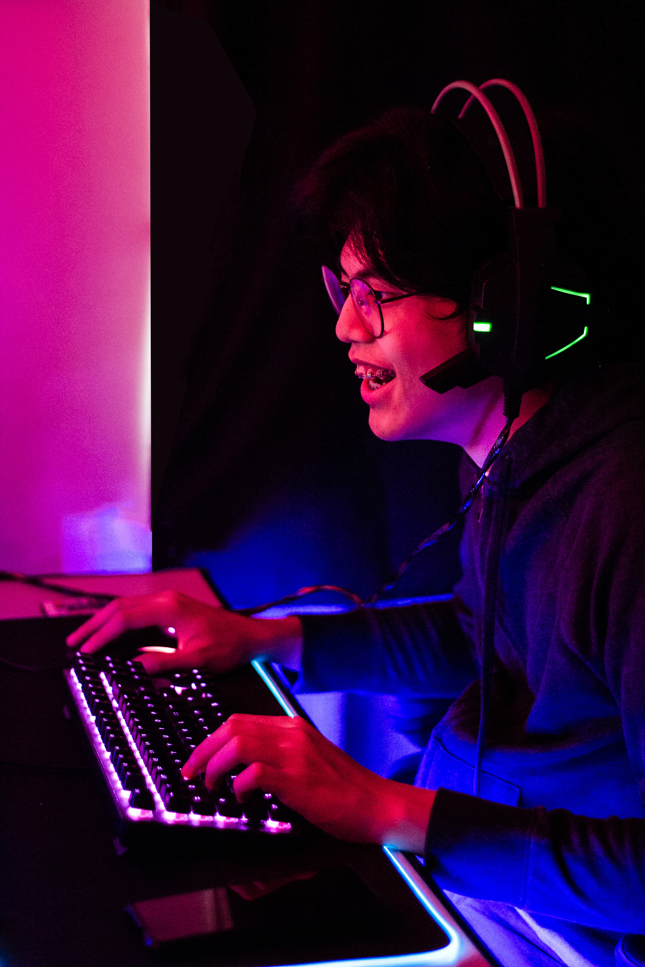
INTRODUCTION
LEAGUE OF LEGENDS (“LOL”) IS A 5V5 MULTIPLAYER ONLINE GAME OF TWO TEAMS IDENTIFIED AS RED AND BLUE, EACH WITH FIVE UNIQUE CHAMPIONS AND A MAIN GOAL: TO DESTROY THE OTHER TEAM’S BASE, CALLED NEXUS, WHICH IS NOT AN EASY TASK.
KEY FACTORS:
GOLD
EXPERIENCE (XP)
CHAMPIONS
SECONDARY OBJECTIVES

Slide 5



RESEARCH QUESTIONS
01
◼Can we predict the result of a LoL match within its first 15 minutes based on the amount of gold and XP earned by each team?
02
◼´Which gameplay and team performance metrics (e.g., dragons, kills , assists, side) have the highest predictive power, and how do they contribute to determining the winner?
03
◼How likely are the secondary objectives able to change the game result?

Slide 6
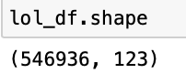
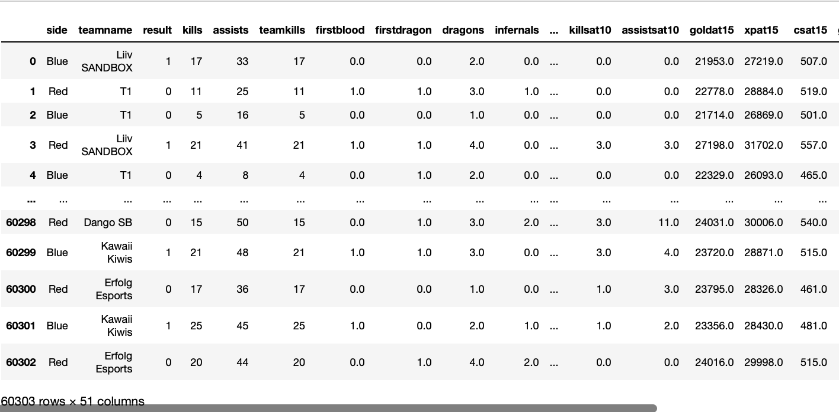
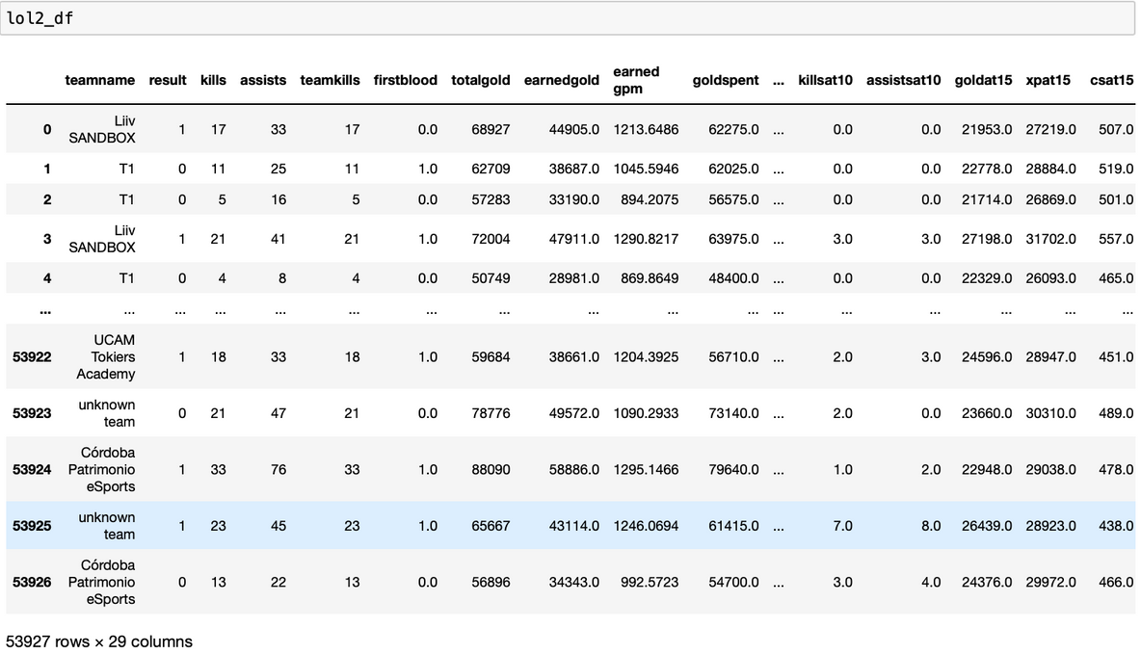

DESCRIPTION OF DATASET
Both data frames have 60303 rows, but they have different features: one data frame has only 29 and the other has 51 features.
The reason we have two data frames is because we are building two models based on two diffrent aspects of the game, therefore we need different features for each model.
In summary, we have created two Dataframes, one for each model.

Slide 7
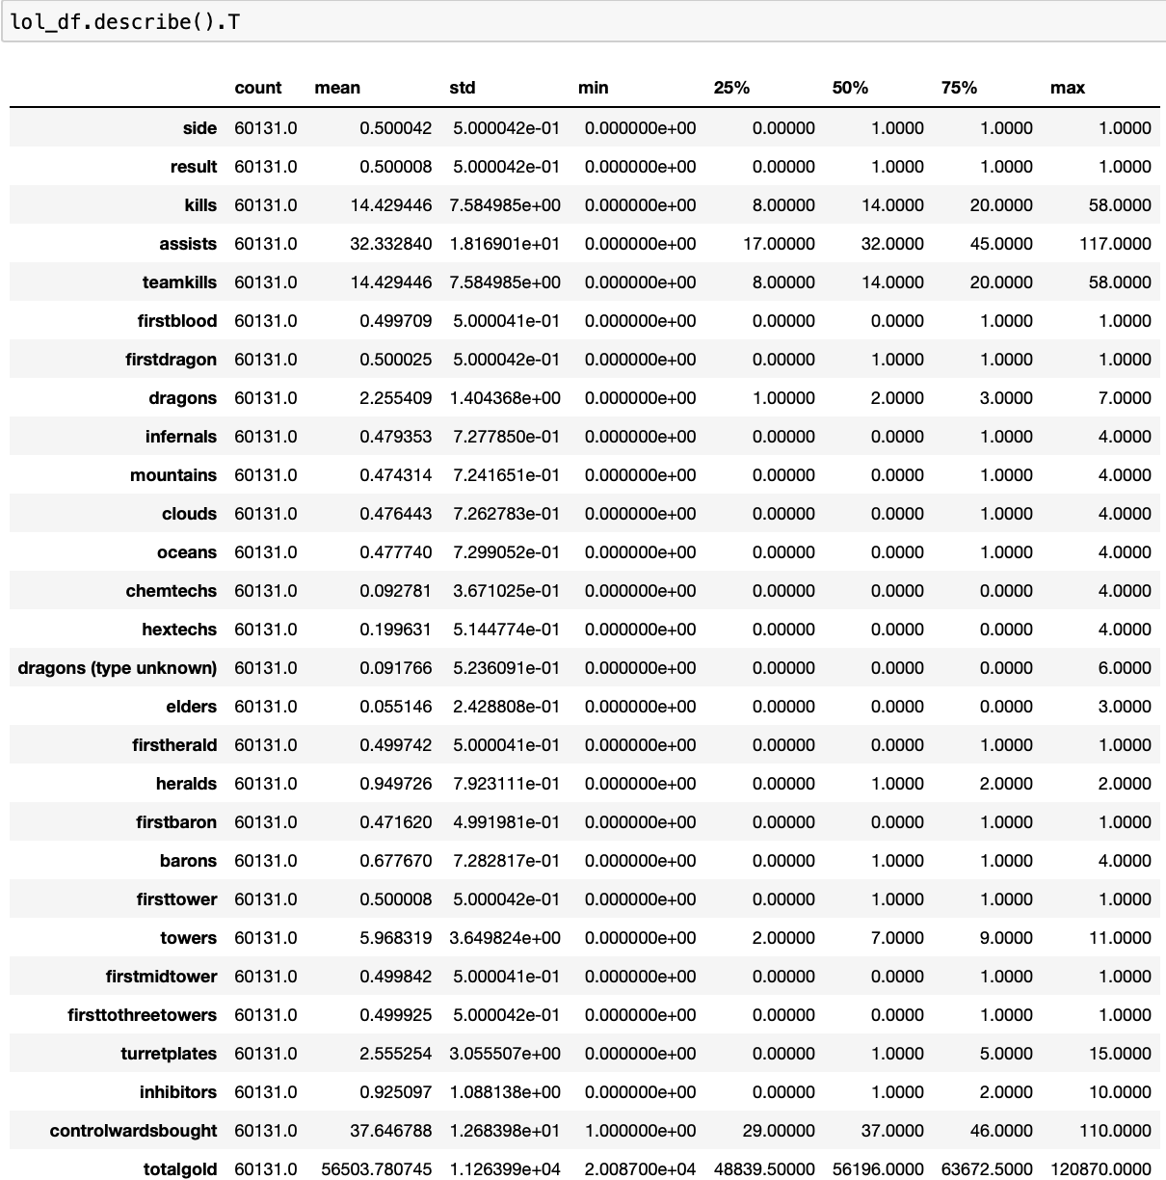
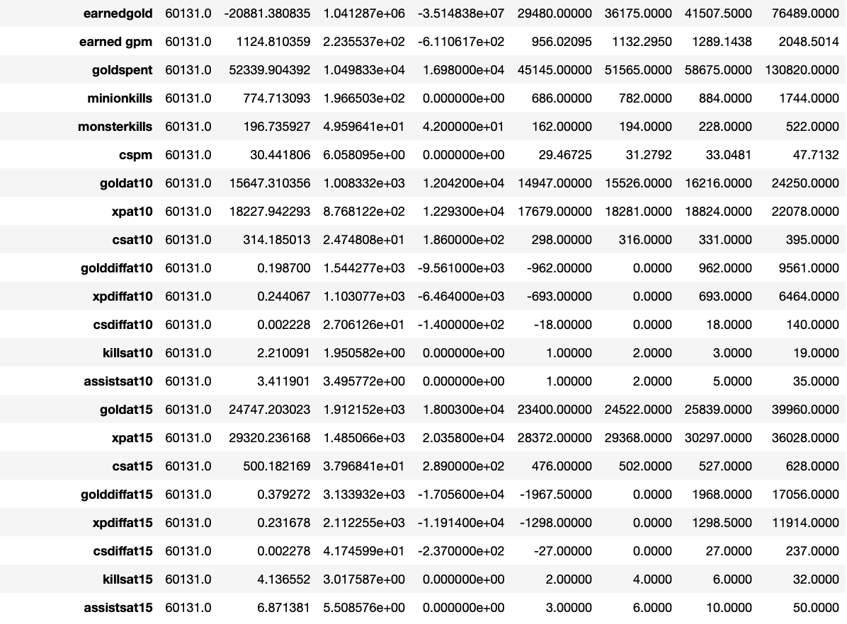
DESCRIPTIVE STATISTICS

Slide 8

Exploratory Data Analysis
Filtered out rows with partial information
Removed columns that were not relevant to analysis
Identified and dealt with missing values appropriately
Checked each dataset for duplicate entries

Slide 9
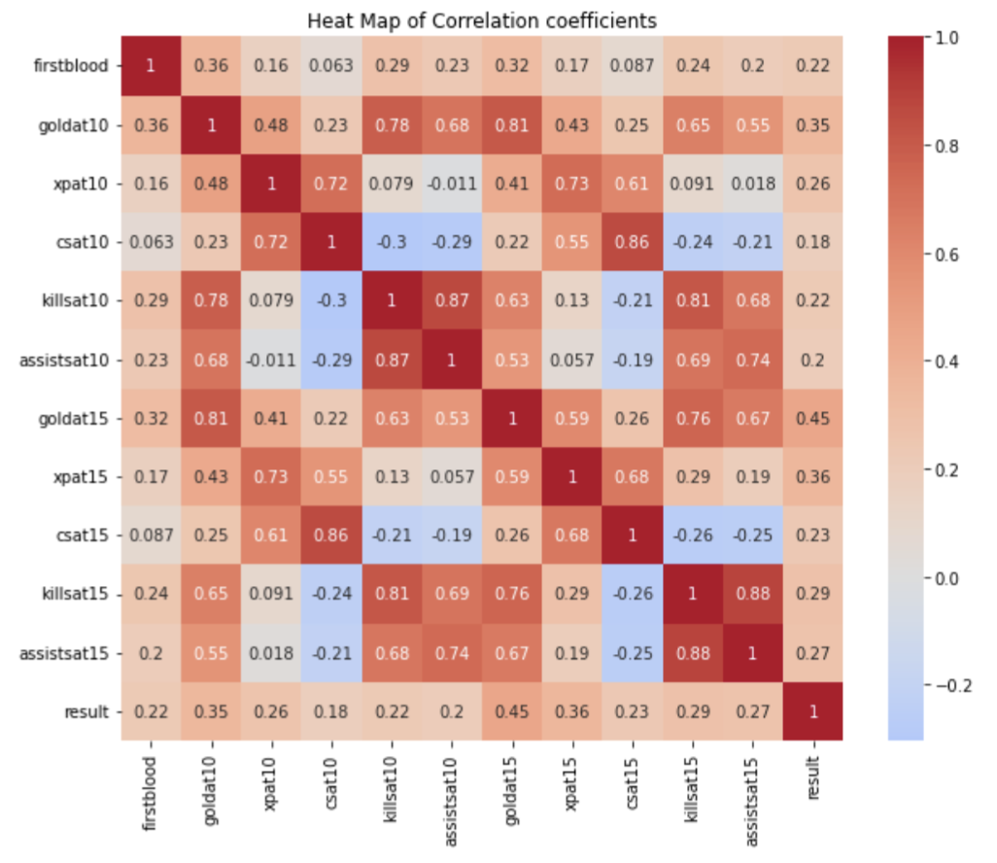
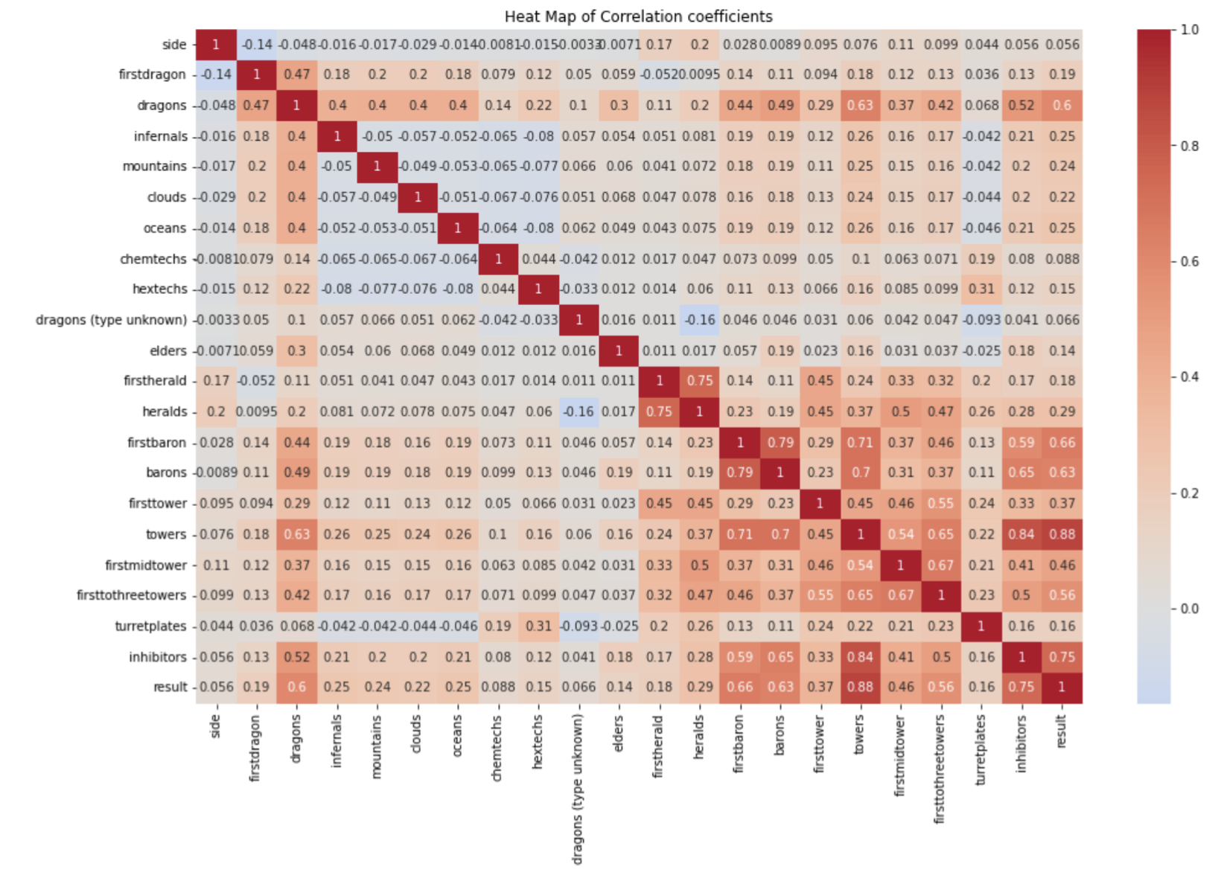
SIGNIFICANT FACTORS

Slide 10
METHODS
01
Logistic Regression
02
Decision Tree
03
XGboost

Slide 11





GUIDLINES:
split train data into remainder/test set and train/validation set
Scale our data
Optimize the data and fit our final data
Create confusion matrix for each model

Slide 12

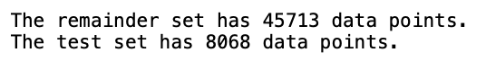
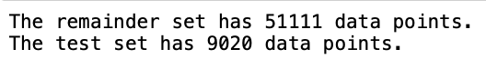
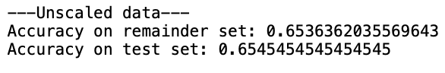
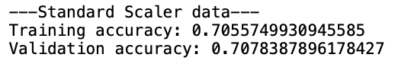
LOGISTIC REGRESSION
Using unscaled data, the model achieved an accuracy of approximately 65.36% on the remainder set and approximately 65.45% on the test set, indicating consistent performance between training and testing data
Standard scaling the data resulted in improved model performance, with a training accuracy of approximately 70.56% and a validation accuracy of approximately 70.78%, indicating a positive impact on model generalization.

Slide 13
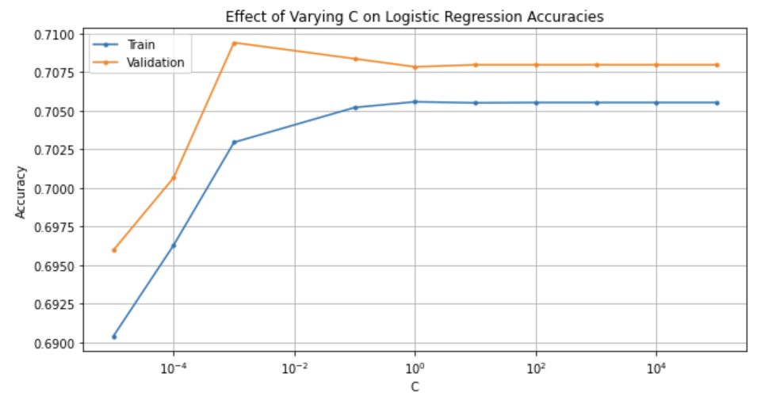
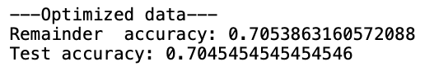
Hyperparameter Optimization:.
HYPER-PARAMETER OPTIMIZATION
The process involves selecting the hyperparameter C, aiming to maximize validation accuracy while avoiding overfitting; a value of 100 is chosen based on the results, as it strikes a balance between high accuracy and simplicity.
With this chosen C value, the final model will be constructed and evaluated on both the remainder and test sets, considering the achieved balance between accuracy and model complexity.
In the optimized model after performing hyperparameter tuning . The remainder set achieved an accuracy of approximately 70.53%, while the test set had an accuracy of approximately 70.45%.

Slide 14
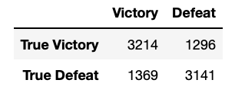
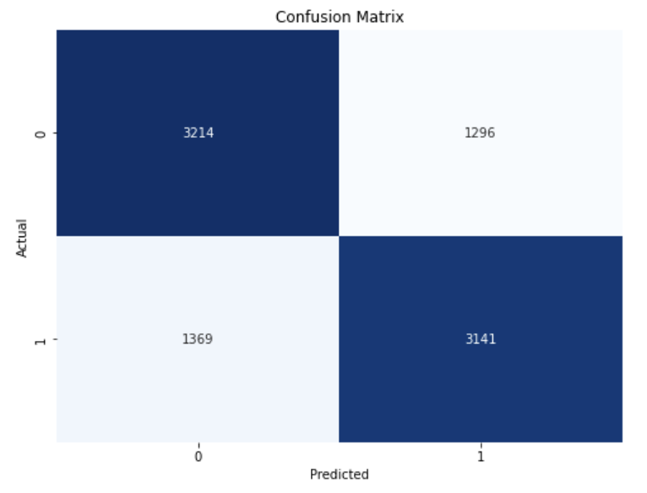
CONFUSION MATRIX- LOGIT MODEL
3,214( ~71.2 %) games were correctly classified for games won
3,141(~69%) games were correctly classified for matches lost.

Slide 15
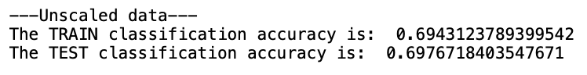
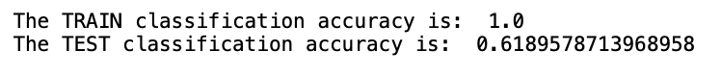
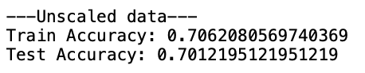
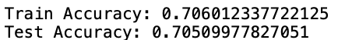
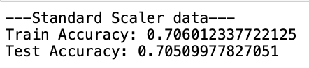
DECISION TREE
The preliminary evaluation indicates that the decision tree base model with a maximum depth of one has outperformed the logistic base model in terms of scores, even though it may suffer from overfitting at this stage.
The next step involves determining the optimal max_depth parameter for the decision tree model to strike the right balance between model complexity and performance, which will guide further model refinement.

Slide 16
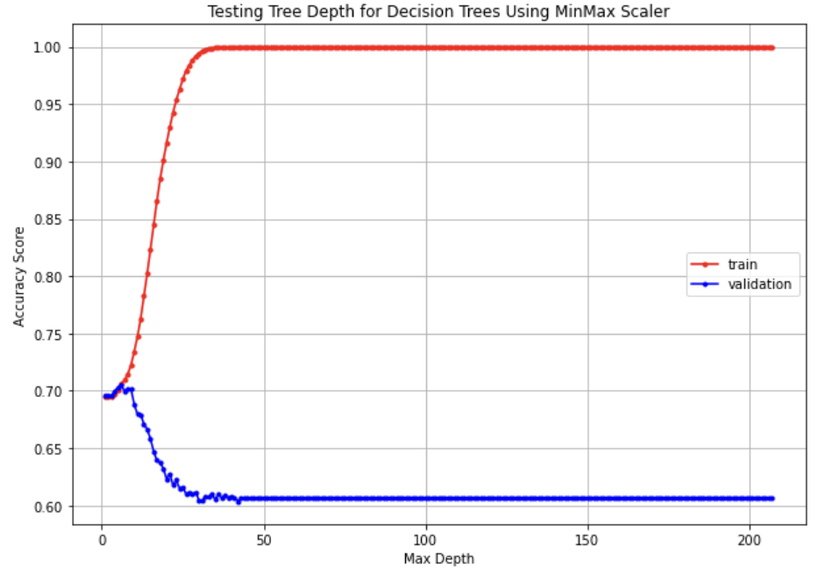
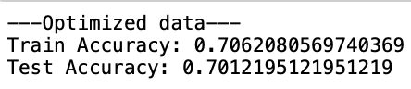
Hyperparameter Optimization:.
HYPER-PARAMETER OPTIMIZATION
We selected max_depth=6 as the model start to overfit beyond that point, and we can see our validation set is starts to drop significantly after that point.
We can notice that in our entire training our decision tree model performance resumed almost the same, and our final and best model in Decision Tree has an accuracy of ~70%
In the optimized model after performing hyperparameter tuning . The remainder set achieved an accuracy of approximately 70.62%, while the test set had an accuracy of approximately 70.12%.

Slide 17
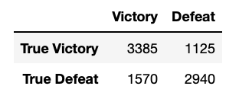
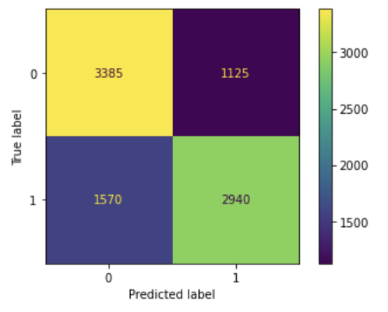
CONFUSION MATRIX- DECISION TREE
3,385( ~75.05 %) games were correctly classified for games won
2,940(~65.18%) games were correctly classified for matches lost

Slide 18
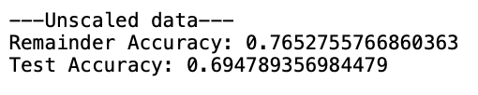
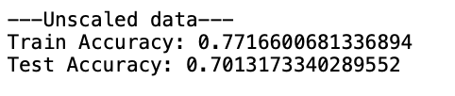
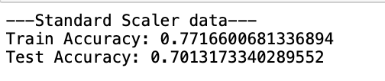

XGBOOST
Using unscaled data, the model achieved a training accuracy of approximately 77.1% and a test accuracy of approximately 70.1%.
After standard scaling the data, the model achieved a training accuracy of approximately 77.17% and a test accuracy of approximately 70.13%.

Slide 19
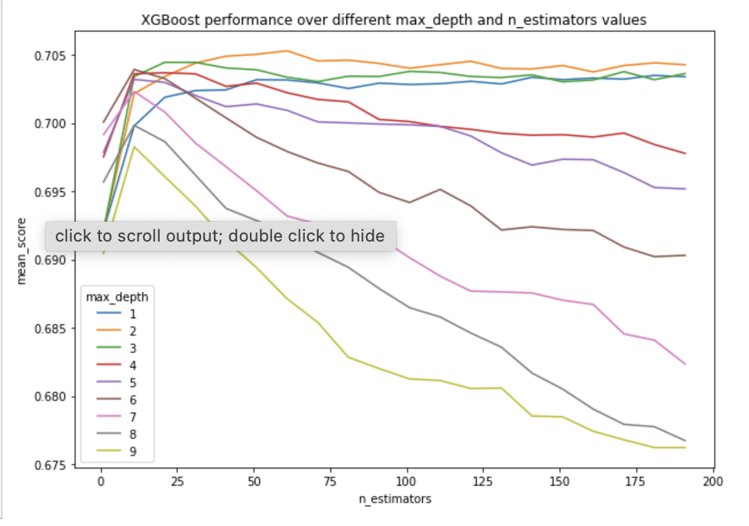
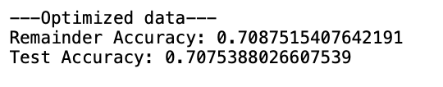
HYPER PARAMETER
As we can see in above max_depth 1 and 2 are kind of going toe to toe, but it seems like max_depth=2 do have slight edge and by checking our best estimator we see that it says the exact same thing and confrims at max_depth=2 our model would be optimized the most.
In the optimized model after performing grid search . The remainder set achieved an accuracy of approximately 70.88%, while the test set had an accuracy of approximately 70.75%.

Slide 20
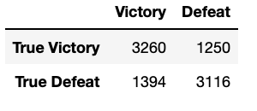
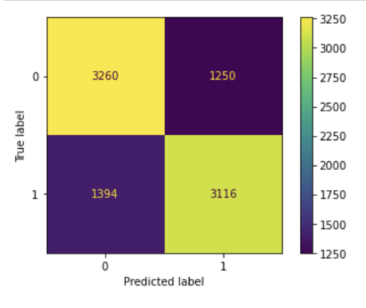
CONFUSION MATRIX- XGBOOST
3,260( ~72.2 %) games were correctly classified for games won
3,116(~69%) games were correctly classified for matches lost

Slide 21

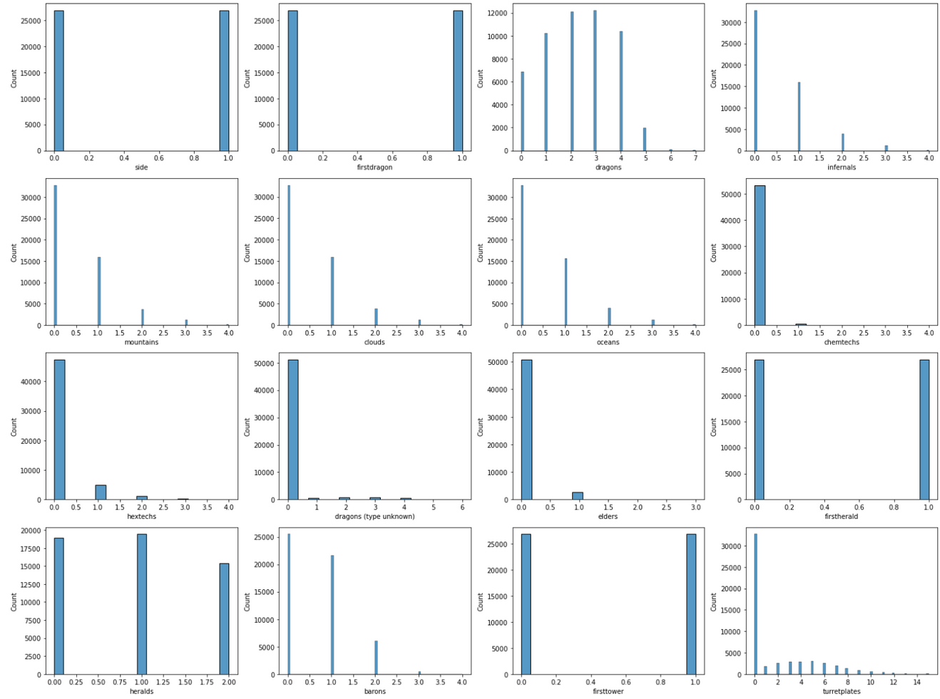
DATA DISTRIBUTION OF SECOND DATAFRAME
We can see we do not have normal distribution anymore and we can say it looks pretty imbalanced.
There is gap between our data distribution and some are skew to left, therefore in this case we will choose MinMax scaler as it works better with non-normal distribution.

Slide 22
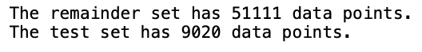
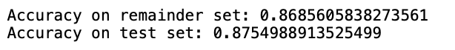
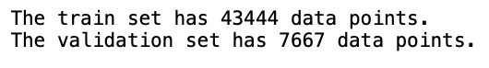
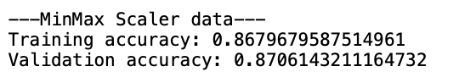
LOGISTIC REGRESSION
Secondry objective affects on the game result
With MinMax scaling applied to the data, the model achieved a training accuracy of approximately 86.80% and a validation accuracy of approximately 87.06%
MinMax scaling helped maintain competitive model performance, with accuracy scores on both the training and validation sets indicating good generalization.

Slide 23
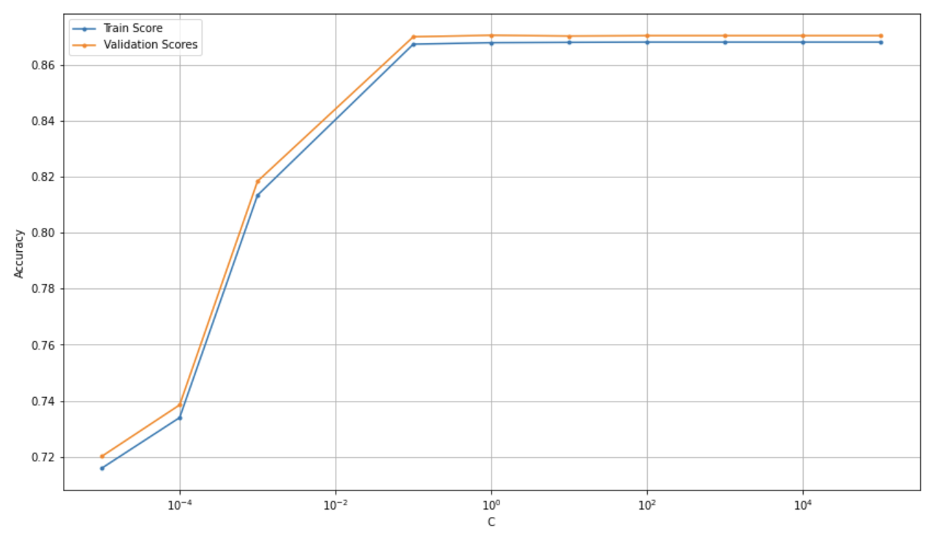
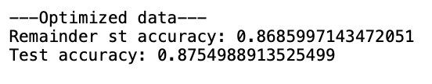
HYPER PARAMETER - LOGISTIC REGRESSION
For our C value here its really close between 1 and 10, but at C value = 10 we do have slight edge and if go back to above table we see slightly better performance and less gap between train and validation sets at C Value=10.
In the optimized model after performing hyperparameter tuning . The remainder set achieved an accuracy of approximately 86.85%, while the test set had an accuracy of approximately 87.54%.

Slide 24
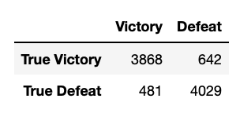
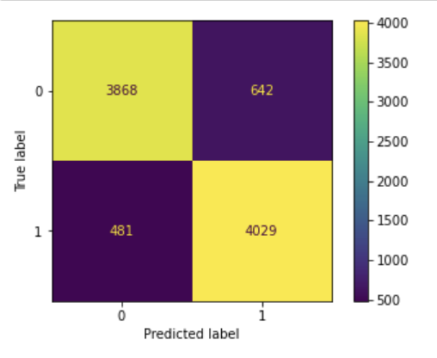
CONFUSION MATRIX- LOGISTIC REGRESSION
3,868( ~85.37 %) games were correctly classified for games won.
4,029(~89.33%) games were correctly classified for matches lost.

Slide 25
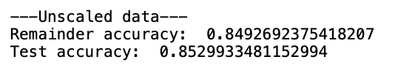
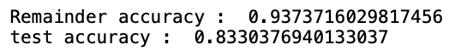
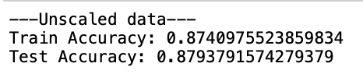
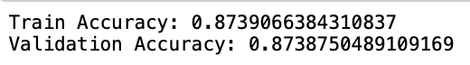
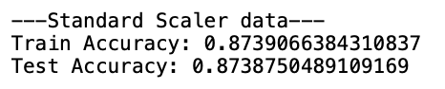
DECISION TREE
After Finding the max_depth:
Using unscaled data, the model achieved a training accuracy of approximately 87.41% and a test accuracy of approximately 87.94%.
Standard scaling the data resulted in consistent performance between the training and test sets, with accuracy scores being similar on both sets

Slide 26
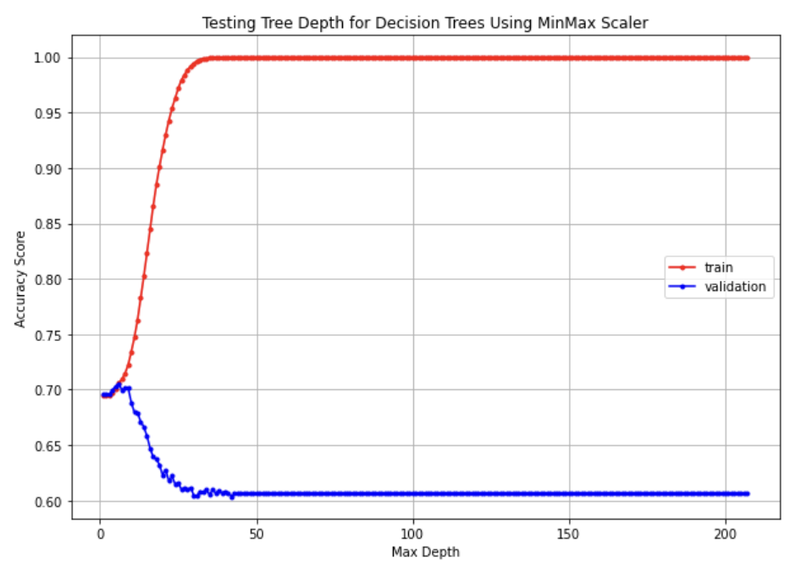
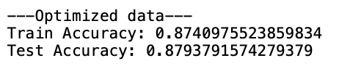
HYPER PARAMETER - DECISION TREE
same as before As we can see after `Max_depth=6` we witnessed drop of our validation set, so we will choose `max_depth=6` to optimize our model.
In the optimized model after performing hyperparameter tuning . The remainder set achieved an accuracy of approximately 87.40%, while the test set had an accuracy of approximately 87.93%.

Slide 27
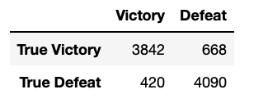
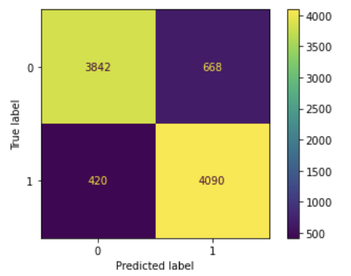
CONFUSION MATRIX- DECISION TREE
3,842( ~85.18 %) games were correctly classified for games won.
4,090(~90.68%) games were correctly classified for matches lost.

Slide 28



XGBOOST
After applying MinMax scaling to the data, the model achieved a training accuracy of approximately 88.62% and a test accuracy of approximately 87.74%.
The MinMax scaled data led to improved model performance, demonstrating higher accuracy scores compared to the previous unscaled .

Slide 29


HYPER PARAMETER - XGBOOST
As we can see after Max_depth=2 we witnessing drop of our validation set, so we will choose max_depth=2 to optimize our model.
In the optimized model after performing hyperparameter tuning . The remainder set achieved an accuracy of approximately 87.76%, while the test set had an accuracy of approximately 88.04%.

Slide 30


CONFUSION MATRIX- XGBOOST
3,818( ~84.60 %) games were correctly classified for games won.
4,124(~90.56%) games were correctly classified for matches lost.

Slide 31


OBSERVATIONS
According to our data and the above graphs, we can confidently say that Blue side has more advantages,
The results reveal surprising findings, with a higher number of assists being more indicative of victory than the number of kills, challenging the initial expectation that the number of kills would be the primary contributing factor to winning.

Slide 32

OBSERVATIONS
The graph shows a perfect distribution of the amount dragons slayed between the winning and the losing teams.
We can confidently say how important this feature is based on amount of dragons the winner team has slayed,

Slide 33



RESULTS

Slide 34



CONTRIBUTION & IMPLICATION
VENKATESH VUYYALA
KOUSALYA KUNAMNENI
SAI VARUN SUNDRU
PREETHI CHILAKALA

Slide 35









THANK YOU

